Slide 1
Industrial cooperation of national SMEs as a driver of the BRICS economic growth
Ekaterina SHAROVA
Academic secretary – head of Scientific planning and development department
Russian Institute for Strategic Studies

Slide 2
SME cooperation
Thursday, May 19, 2016
India Moots Framework for
SME Sector Cooperation in BRICS
India is working on a mechanism to boost cooperation amongst small and medium enterprises in the five-nation BRICS to promote joint ventures and share expertise on strengthening the sector
Source: http://www.thehindubusinessline.com

Slide 3
BRICS industrial competitiveness
 | Brazil | Russia | India | China | South Africa
Share of industry in GDP in 2015 (%) | 22.2 | 35.8 | 29.5 | 42.7 | 30.3
Industrial production growth rate in 2015 (%, place in the rating) | -5 | -3.5 | 2.8 | 7 | 1.7
 | 190 | 185 | 92 | 16 | 125
Place in the rating of industrial production competitiveness (of 142 counties) in 2014 | 36 | 32 | 44 | 5 | 42
Manufacturing Value-added (MVA) in 2014 (bln USD) | 146.6 | 139.4 | 213.5 | 1699 | 47.4
MVA per capita in 2014 (USD) | 726 | 978 | 168 | 1219 | 891
Share of MVA in GDP in 2014 (%) | 13% | 14% | 14% | 33% | 15%
Place in the top twenty of the leading countries by the industrial production index in 2014 | 11 | 10 | 6 | 1 | -
Sources: UNIDO, World Bank, CIA World Factbook

Slide 4
Technological structure of intra-BRICS trade
Exporting country | Group of partner countries | Share in export of products of various value-added level in 2015 (%)
 |  | Primary and resource-based products | Low-technology products | Middle-technology products | High-technology products
Brazil | BRICS | 90% | 2% | 6% | 1%
 | World | 69% | 7% | 19% | 5%
Russia | BRICS | 79% | 2% | 15% | 3%
 | World | 81% | 5% | 11% | 4%
India | BRICS | 50% | 23% | 21% | 5%
 | World | 49% | 27% | 18% | 5%
China | BRICS | 14% | 33% | 28% | 26%
 | World | 11% | 33% | 22% | 34%
RSA | BRICS | 80% | 2% | 17% | 1%
 | World | 57% | 8% | 31% | 4%
Source: UN Comtrade

Slide 5
Common features of the BRICS industrial development programs
Based on implementation of import substitution policies and export support
Key role of the government (investments, development banks and other institutions, public-private partnerships, public procurement
Development of national standards and their harmonization with international standards
Provision of personnel training and promoting productivity growth
Formation of analytical and research centres for supporting industrialization
Special zones, technology parks and clusters
Trade and investment agreements with key partner countries

Slide 6
Sector priorities
Industries | Brazil | Russia | India | China | South Africa
Aerospace | “Brasil Maior” | Policy Priorities of the Government of the Russian Federation to 2018 | National Industrial Policy, “Make in India” | “Made in China” | National Industrial Policy Framework and Industrial Policy Action Plan 2016-17
Motor vehicles | “Brasil Maior” | “Development of Industry and Improvement of Its Competiveness” | National Industrial Policy, “Make in India” |  | National Industrial Policy Framework and Industrial Policy Action Plan 2016-17
Information technology | “Brasil Maior” | Policy Priorities of the Government of the Russian Federation to 2018 | “Make in India” | “Made in China”
Light industry | “Brasil Maior”, Brazil Productivity Program 2016 | “Development of Industry and Improvement of Its Competiveness” | National Industrial Policy, “Make in India”, Foreign Trade Policy of India in 2015-2020 |  | National Industrial Policy Framework and Industrial Policy Action Plan 2016-17
Machinery metallurgy | “Brasil Maior”, Brazil Productivity Program 2016 | “Development of Industry and Improvement of Its Competiveness” | Foreign Trade Policy of India in 2015-2020 |  | National Industrial Policy Framework and Industrial Policy Action Plan 2016-17
Defence | “Brasil Maior” | “Development of Industry and Improvement of Its Competiveness” | National Industrial Policy, “Make in India”
Food industry | “Brasil Maior”, Brazil Productivity Program 2016 | “Development of Industry and Improvement of Its Competiveness” | National Industrial Policy, “Make in India” |  | National Industrial Policy Framework and Industrial Policy Action Plan 2016-17
Shipbuilding | “Brasil Maior” | Policy Priorities of the Government of the Russian Federation to 2018 | National Industrial Policy | “Made in China” | National Industrial Policy Framework and Industrial Policy Action Plan 2016-17
Pharmaceuticals and medical equipment | “Brasil Maior” | Policy Priorities of the Government of the Russian Federation to 2018 | National Industrial Policy, “Make in India”, Foreign Trade Policy of India in 2015-2020 | “Made in China” | Industrial Policy Action Plan 2016-17
Electronic and radio-electronic technology |  | Policy Priorities of the Government of the Russian Federation to 2018 | National Industrial Policy, “Make in India”, Foreign Trade Policy of India in 2015-2020 | “Made in China” | National Industrial Policy Framework and Industrial Policy Action Plan 2016-17

Slide 7
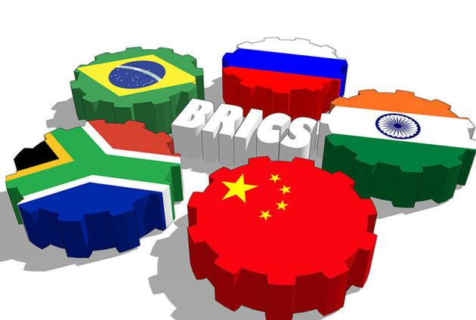
Sector priorities
National champions
Strategic industries which require foreign technologies
Labour-intensive industries
Primary industries

Slide 8
Proposals
Cooperation of national institutions responsible for support of SMEs and implementation of governmental programs in the industrial sector
Creation of special single-window centres
Harmonization of national technical standards and their promotion at the international level
Transition from the program-based to the project-based approach to industrial cooperation with the BRICS
(eg. through the filling of the BRICS Roadmap for Investment Cooperation with high-tech projects involving national SMEs
and giving it the status of the strategic document in the
NDB BRICS)
Merging work on increase of labour productivity
through the exchange of experts, joint training of SMEs’
representatives, organization of scientific works and
industrial projects

Slide 9
Thank you!
Russian Institute
for Strategic Studies:
Centre for Economic Research
Centre for Asia and Middle East
Centre for Euro-Atlantic and Defence Studies
Centre for Baltic and CIS Countries Studies
Centre for Social Studies
Ekaterina SHAROVA
Academic secretary – head of Scientific planning and development department
E-mail: Ekaterina.Sharova@riss.ru
E-mail2: Ekatsharova@mail.ru
WWW.RISS.RU

